Slide 1

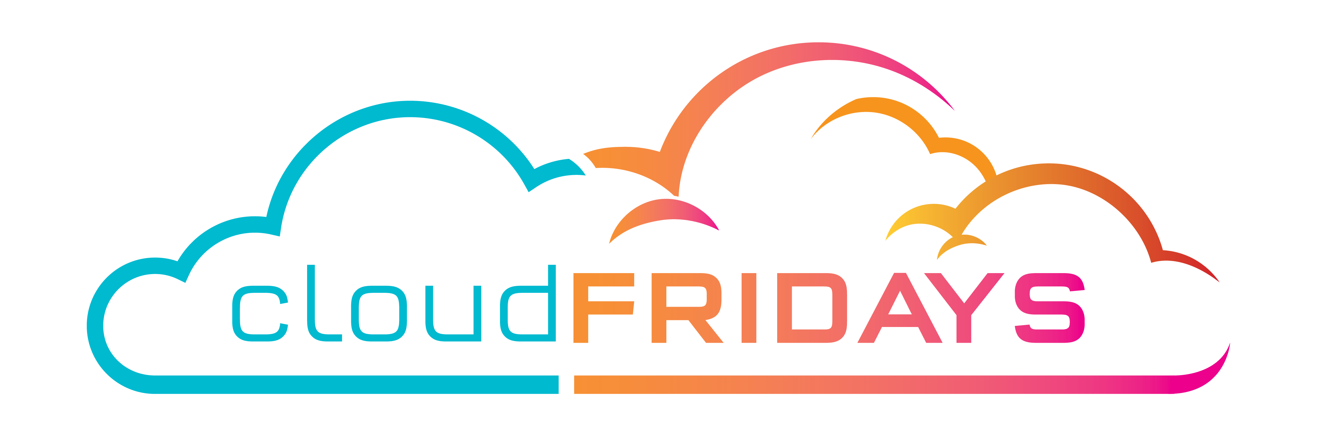
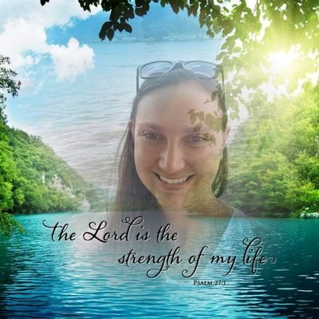
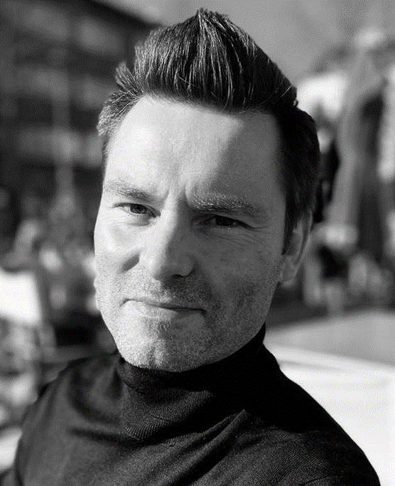
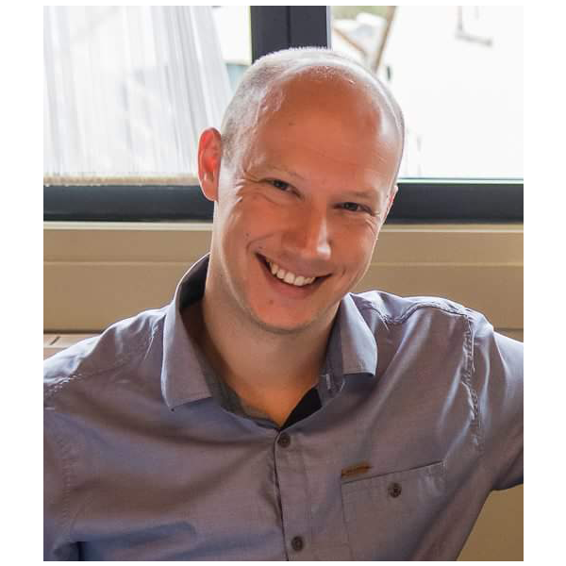
Cloud Fridays - August 2022 - IaaS VMs and Security
Title | Speakers | Scheduled At
Create Azure Resources from a Power App in Teams | Carike Botha | 12 Aug 2022 09:15 AM
Azure Bastion: One does (still) not simply walk into my VNet! v2.0 | Wim Matthyssen, Micha Wets | 12 Aug 2022 10:30 AM
https://www.meetup.com/cloud-fridays/

